Slide 1
Good Morning! 早上好! 안녕하세요!
Day 2

Slide 2
Day1 recap

Slide 3
2 projects
Mini Project (Individual Team)
For learning techniques
Final Project (2 Teams in One)

Slide 4
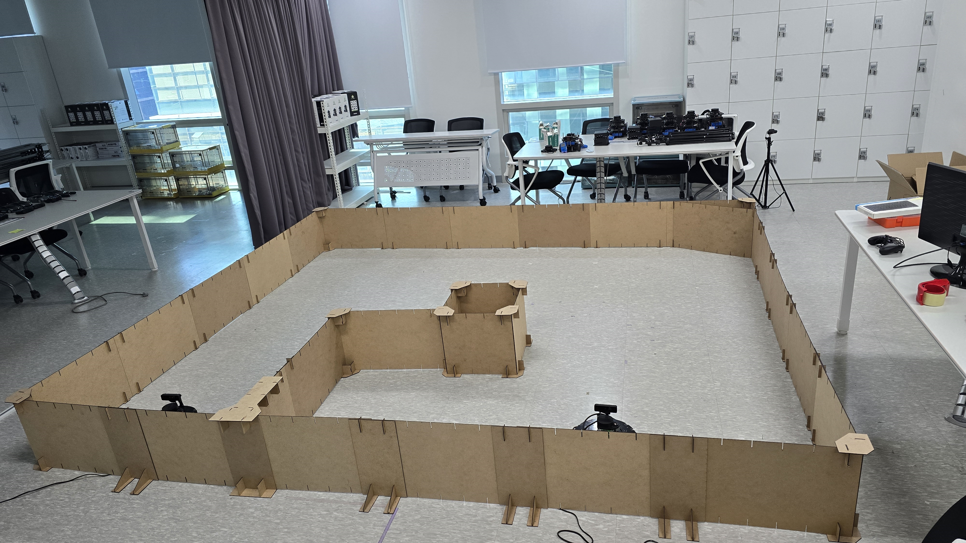
Mini Project Description

Slide 5
Key subsystem (Modules) to develop
Detection Alert
Camera Capture
Object Detection
Send messages to other subsystems
AMR Controller
Receive messages and act accordingly
Move using (SLAM) with Obstruction avoidance
Target Acquisition (Obj. Det.) and Tracking
Follow target using camera and motor control
System Monitor
Receive and Display Security Camera and info
Receive and Display AMR Camera and info
Store, display, and report Information and Alerts

Slide 6
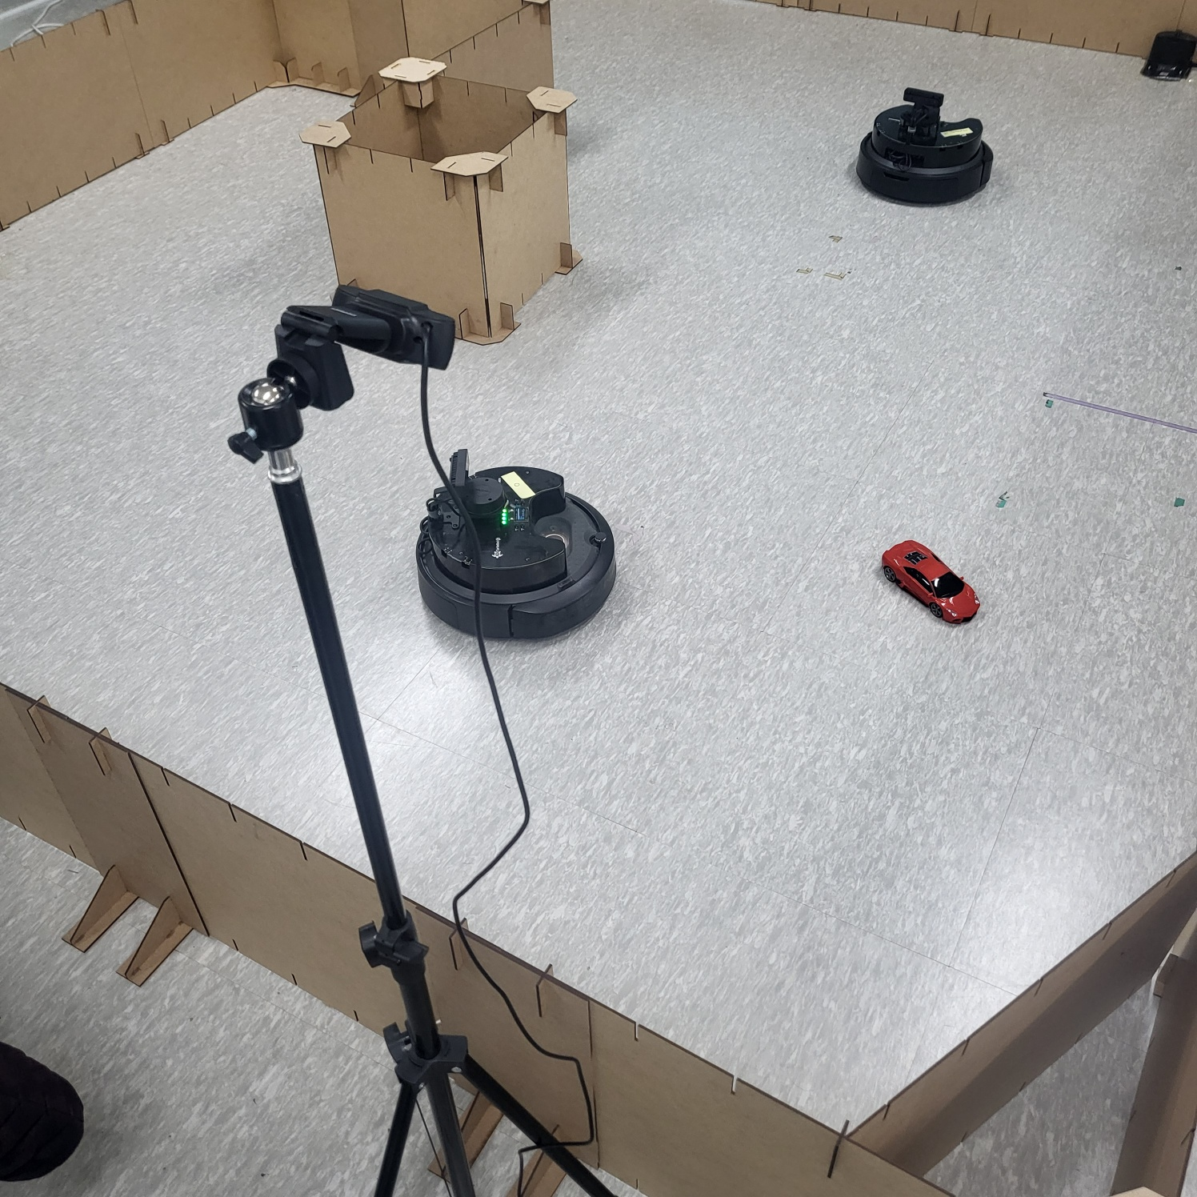
Detection Alert

Slide 7
Start

Slide 8
Navigate

Slide 9
Track & Follow

Slide 10
Day 1
Welcome
Project Introduction
Introduction to Project Development Process
Business Requirement Development
System Requirement Development
System(High Level) Design
Time Management

Slide 11
Day 2 (Mini project)
Yolo객체 인식 모델 활용과 성능 평가 방법 이해
Custom Dataset과 Fine Tuning으로 자체 객체 인식 모델 구현 및 평가
(Optional)Segmentation,Tracking,경량화 모델 등 개별 요구사항에 적합한 모델 탐색 및 성능 검증
YOLOv8 기반 데이터 수집/학습/deploy (Detection Alert)
감시용 데이터 수집(bus, truck, tank 등)
감시용 데이터 라벨링
YOLOv8 기반 학습
YOLOv8 Object Detection
Porting to ROS
Create Detection Alert Node
Generate Topics to send image and Obj. Det. results
Create Subscriber node and display image and print data from the Topic

Slide 12
Day 3 (Mini project)
AMR(Autonomous Mobile Robot) Turtlebot4 개발 환경 구축
로봇 개발 환경에 완성 모델 서빙 및 테스트 / 로봇 H/W, 제반 환경의 한계점 도출
Tracking 데이터 수집(bus, truck, tank 등)
Tracking 데이터 라벨링
YOLOv8 기반 학습
YOLOv8 Object Tracking
Turtlebot4 시뮬레이션 환경 구축
SLAM과 Map 생성 및 파라미터 튜닝(Localization, AMCL)
AutoSLAM으로 맵 생성

Slide 13
Day 4 (Mini project)
Turtlebot4 Navigation과 파라미터 튜닝(Local Costmap, Global Costmap)
Turtlebot4 API를 활용한 Initial Pose Navigate_to Pose 구현
Turtlebot4 API를 활용한 Navigate_Through_pose, Follow Waypoints 구현
로봇 개발 환경에 적용 및 테스트 / 로봇 H/W, 제반 환경의 한계점 도출
AMR기반 카메라 인식 autonomous driving 시스템 with obstacle avoidance 구축 (AMR Controller)
Digital Mapping of environment
Goal Setting and Obstacle Avoidance using Navigation
Object Tracking w/ AMR camera
Control logic between navigation/obj. tracking/ obj. following (teleop)
Porting to ROS
Create AMR Controller Node
Create and send Obj. Tracking Image and data to Sysmon
Integrate and test with Detection

Slide 14
프로젝트 rule
80/20 20/80

Slide 15

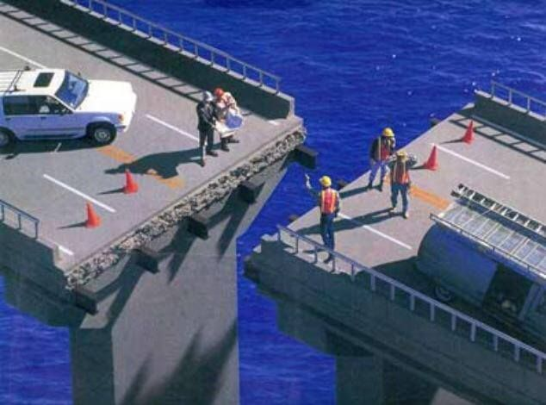
Teamwork and Project Management

Slide 16
How to work together
Participate, Participate, Participate!!!
No long emails or Kakaotalk, prefer face to face
Be open to suggestions and idea
Be proactive, take initiative
HOW is as important as WHAT

Slide 17

Brainstorming Rules
Every input is good input
Do not critique inputs only seek to understand
Organize inputs into logical groupings
Sequence or show relationships as needed
Use Posted Notes on Flip Chart

Slide 18

프로젝트 rule number ONE!!!
Have Fun Fun Fun!

Slide 19
Project development Is a Process

Slide 20
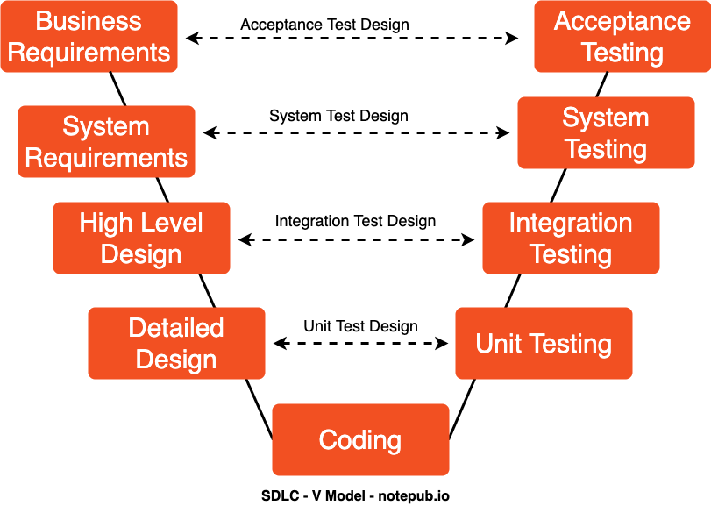
SW Development Process
Why and What

Slide 21
Team Exercise 1
Brainstorm Business Requirement for the project and write business requirement statement

Slide 22
SW Development Process
With What
And
How Much

Slide 23
Team Exercise 2
Brainstorm System Requirement for the project and document

Slide 24
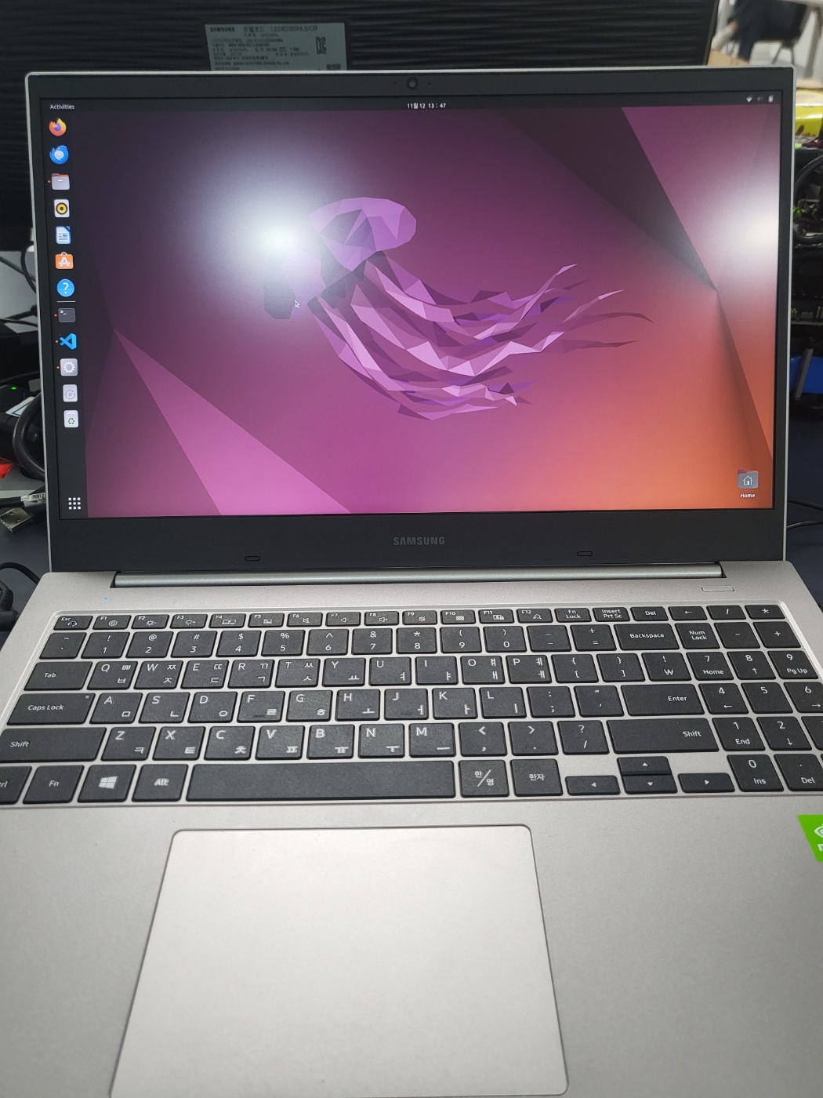
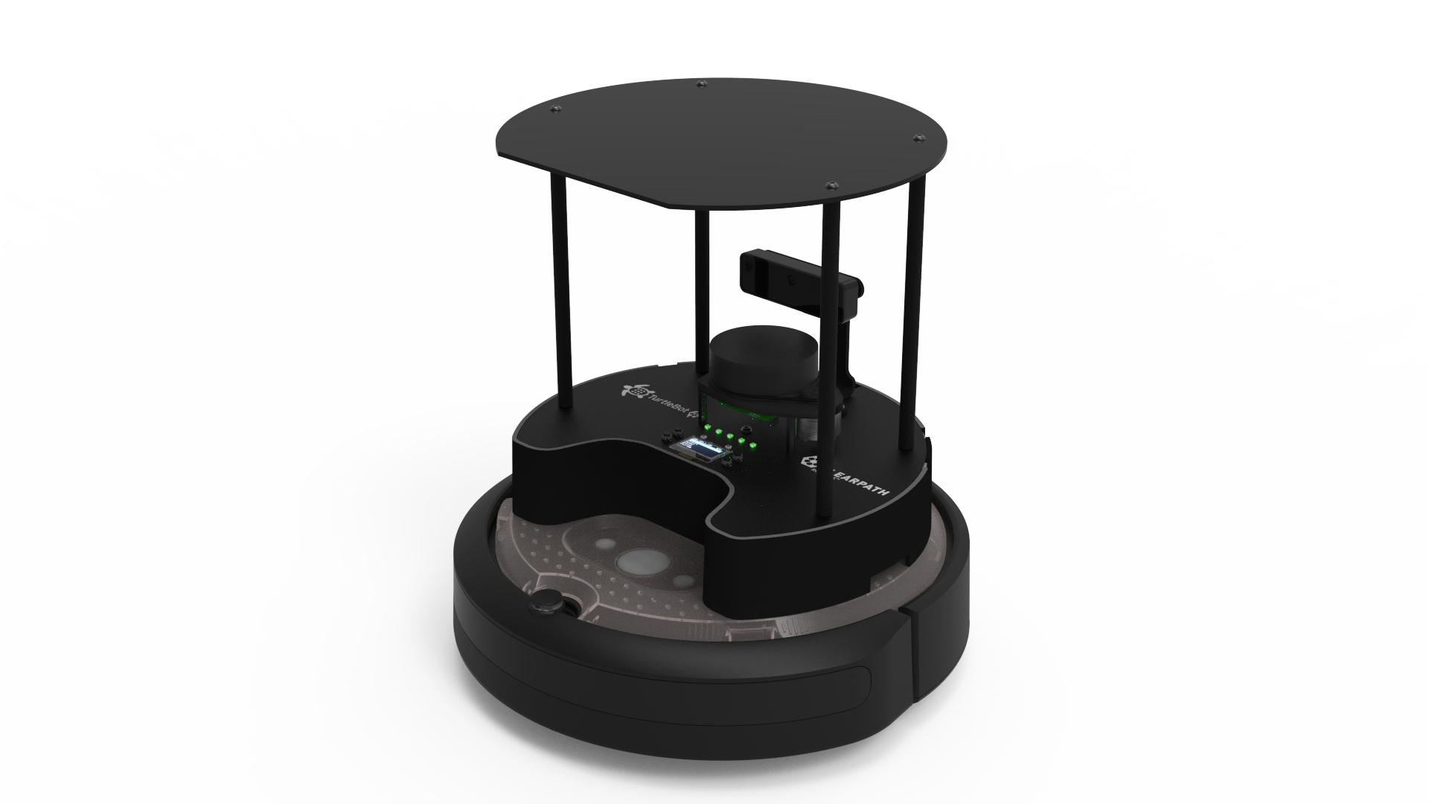
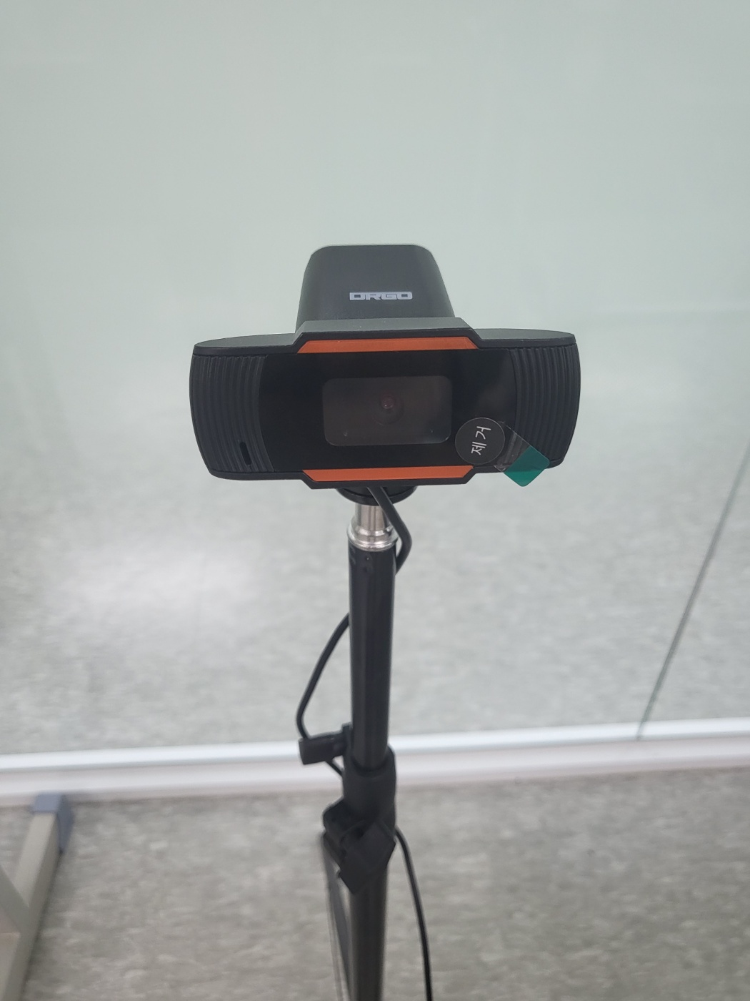
Base HW/OS
PC
Ubuntu 22.04
USB Camera
Network
Wifi
AMR
TurttleBot4
Ubuntu 22.04

Slide 25
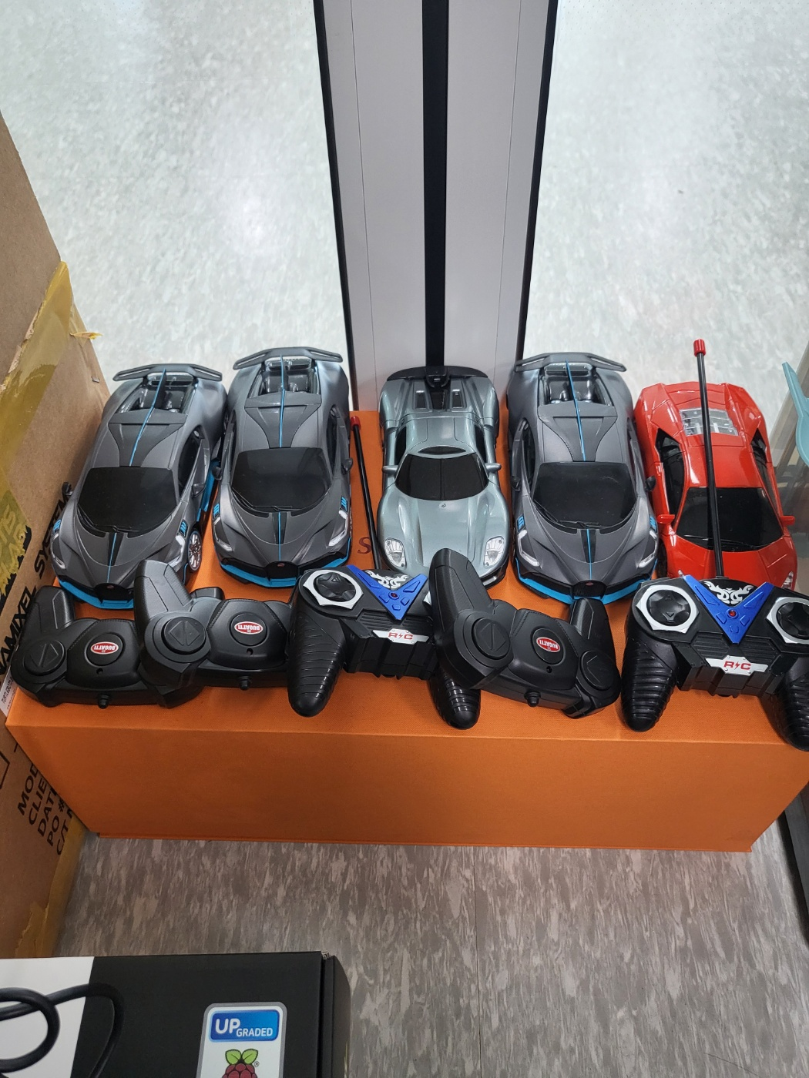
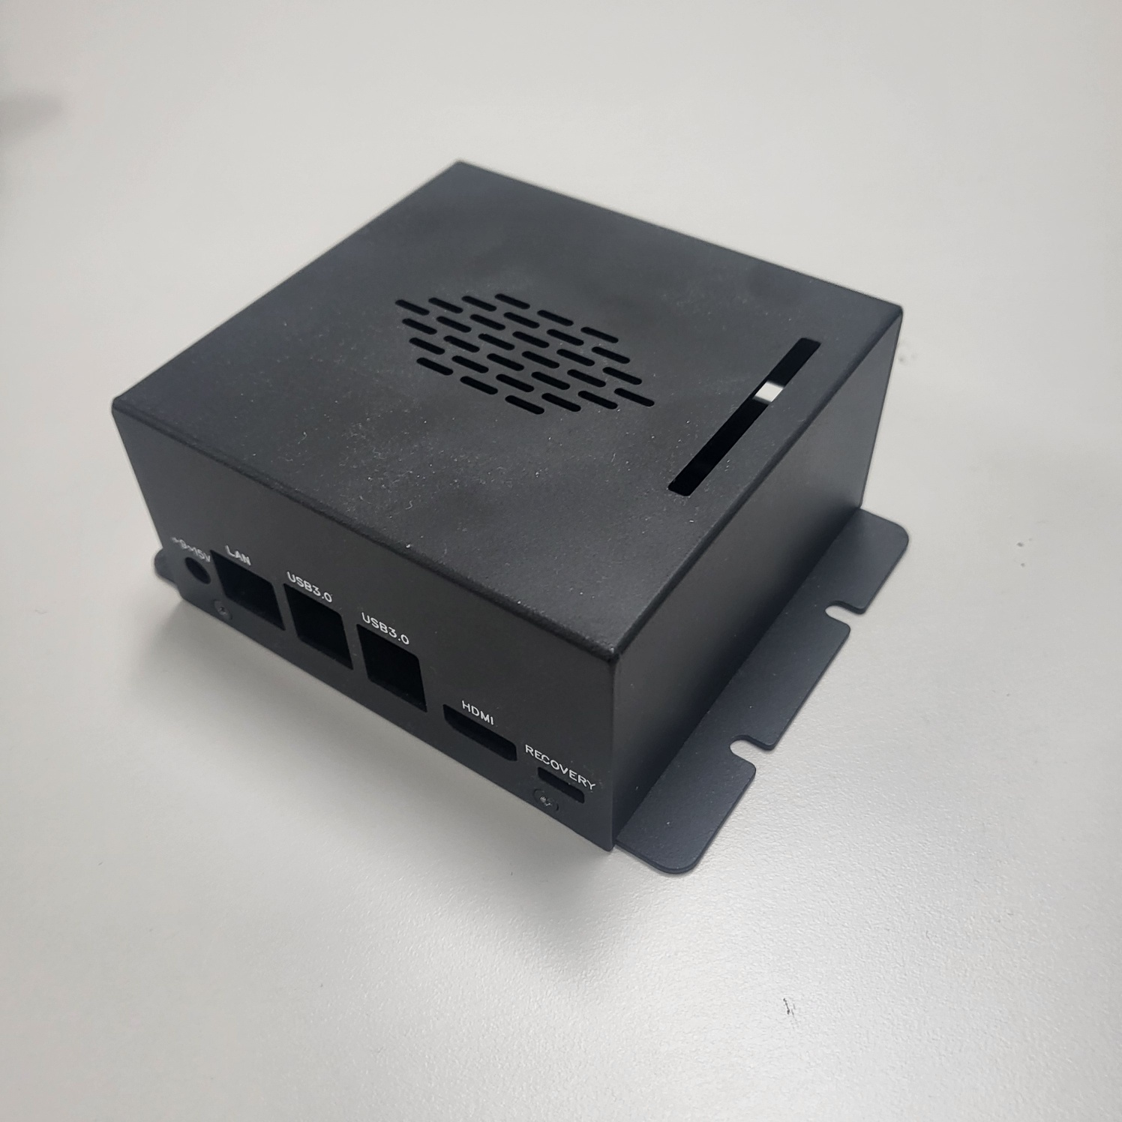
Obj. Det.
Target
Dummy

Slide 26
Example System Stack
Virtual Environment
Application
Lib/Packages/Language
Database
OS
HW

Slide 27
Packages
PC
AMR
Python3
ROS2
Opencv
Ultralytics
Flask
SQLite3
Python3
ROS2
Opencv
Ultralytics

Slide 28
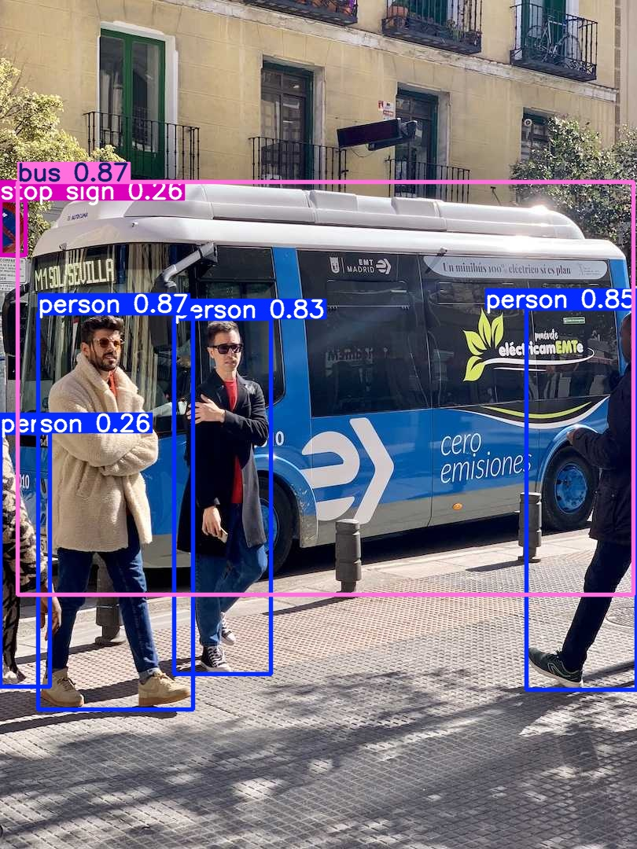
Yolo obj. Det. Vs. Yolo Tracking
Yolo Obj. Detection
Yolo Tracking
(469) YOLO people detection + SORT tracking – YouTube
Bing Videos
Track - Ultralytics YOLO Docs

Slide 29
AMR demo
User Manual · Turtlebot4 User Manual
https://turtlebot.github.io/turtlebot4-user-manual/
Navigation with SLAM
Teleop with keyboard

Slide 30
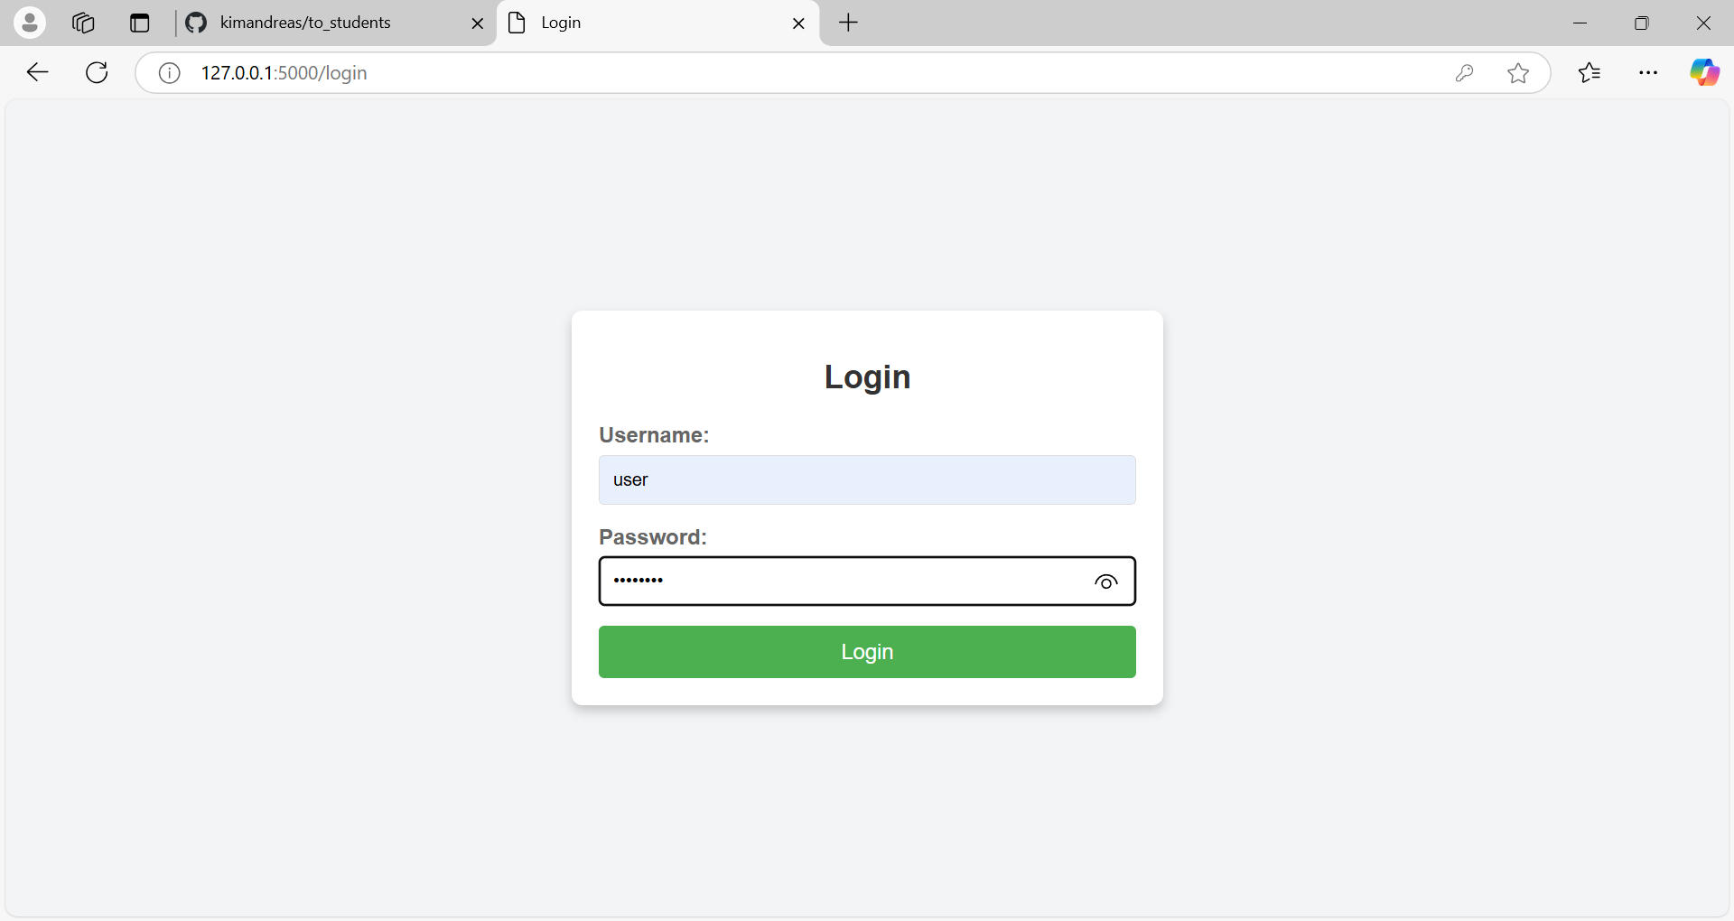

Slide 31
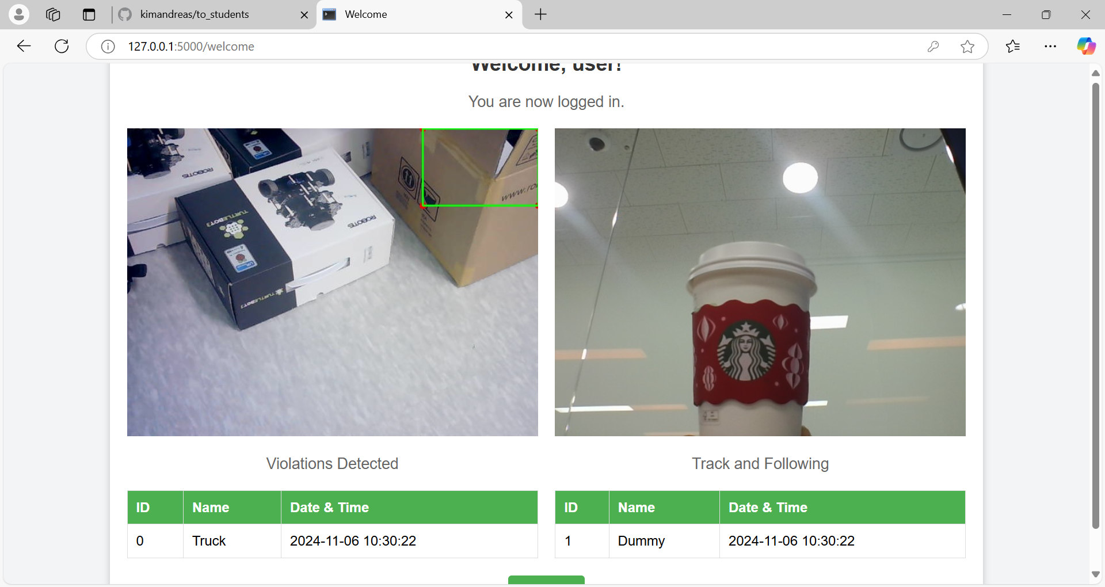

Slide 32
SW Development Process
HOW:
Where,What,
When,How Much

Slide 33
Key subsystem (Modules) to develop
Detection Alert
Camera Capture
Object Detection
Send messages to other subsystems
AMR Controller
Receive messages and act accordingly
Move using (SLAM) with Obstruction avoidance
Target Acquisition (Obj. Det.) and Tracking
Follow target using camera and motor control
System Monitor (OPTION)
Receive and Display Detection Camera and info
Receive and Display AMR Camera and info
Store, display, and report Information and Alerts

Slide 34
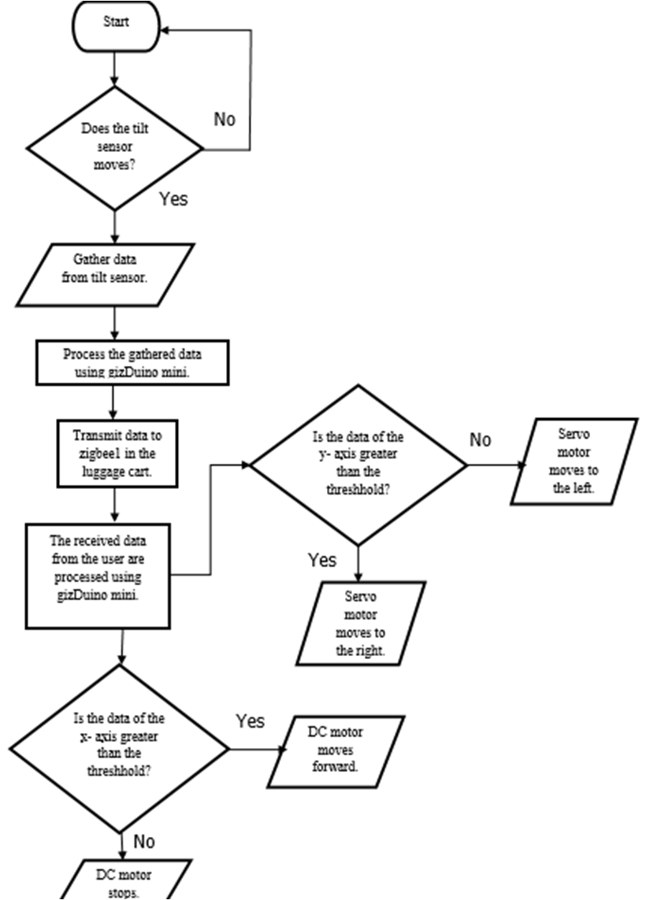
Visualization – system functional process Flow diagrams
To-Be Functional Process Flow Diagram
Detection Alert
System Monitor
AMR Controller
Functions
Interfaces
Dataflow
Testing
Error and Exception Handling

Slide 35
Team Exercise 3
Create System Design using Process Flow Diagram.
Use the posted notes and flipchart as needed

Slide 36
system Design presentation by each team

Slide 37
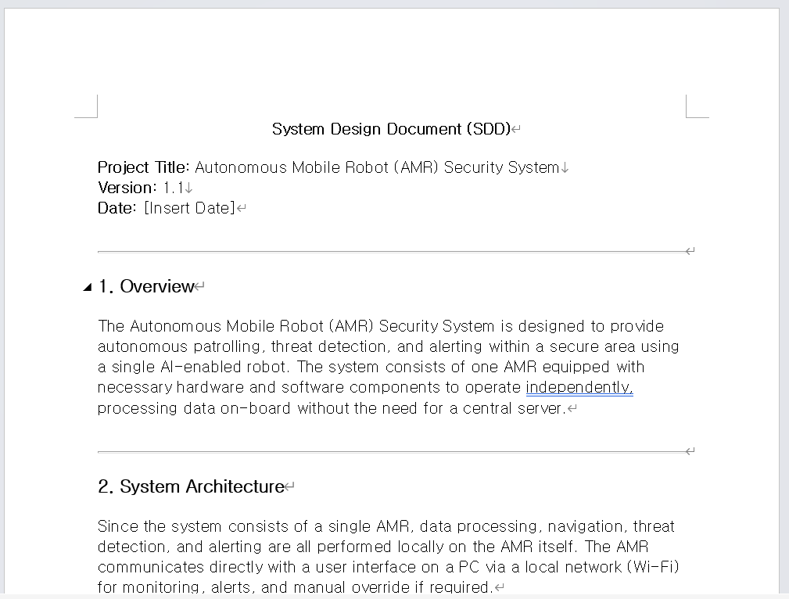
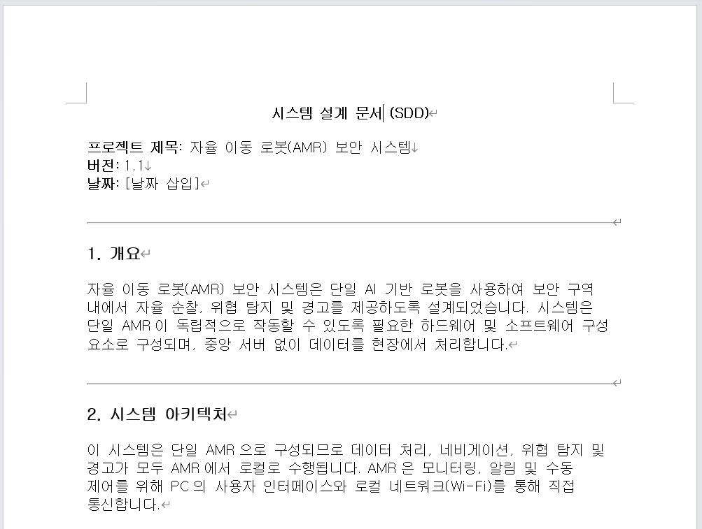
Example System Design Document

Slide 38
Project timeline/Critical path item management

Slide 39
EX. Implementation timeline
이 타임라인을 생성할 때 먼저 시스템 및 시스템 설계의 기능 프로세스 다이어그램(To-Be)을 완료해야 합니다.
그런 다음 각 기능(하위 함수/모듈 및 입력/출력)에 대해 누가, 무엇을, 언제, 어떻 게를 정의합니다. 표에 설명 타임라인 형식의 무엇을, 누가, 언제를 입력합니다.

Slide 40
Critical Path items list
tasks that directly impact the project timeline. Delays in these tasks would delay the project's overall completion because they represent the longest stretch of dependent activitie
프로젝트 타임라인에 직접적인 영향을 주는 작업입니다. 이러한 작업이 지연되면 종속 활동이 가장 길어지기 때문에 프로젝트의 전체 완료가 지연됩니다s

Slide 41
Day 2

Slide 42
Detail Design to User Acceptance

Slide 43
SW Development Process

Slide 44
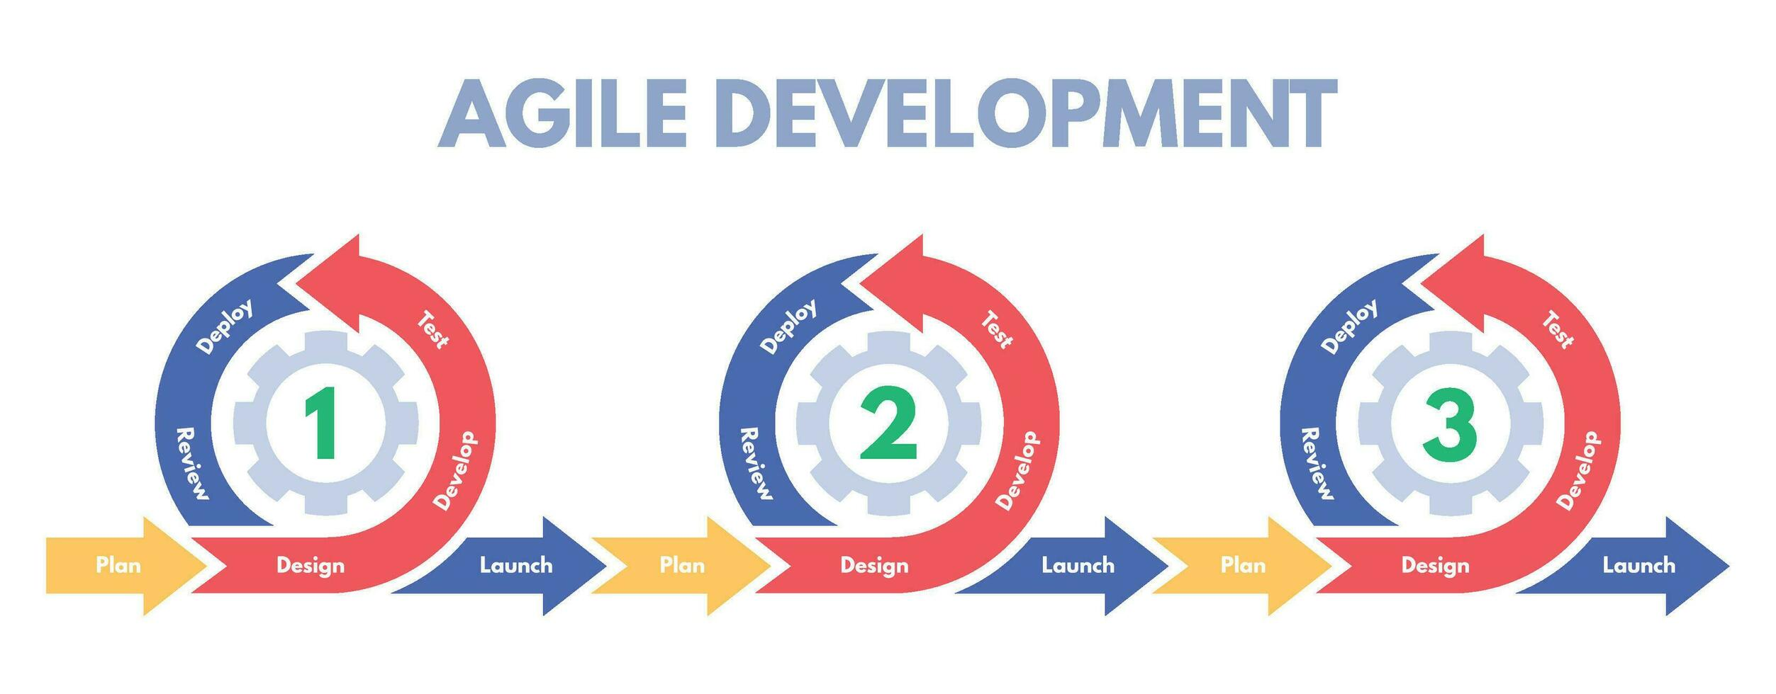

Slide 45
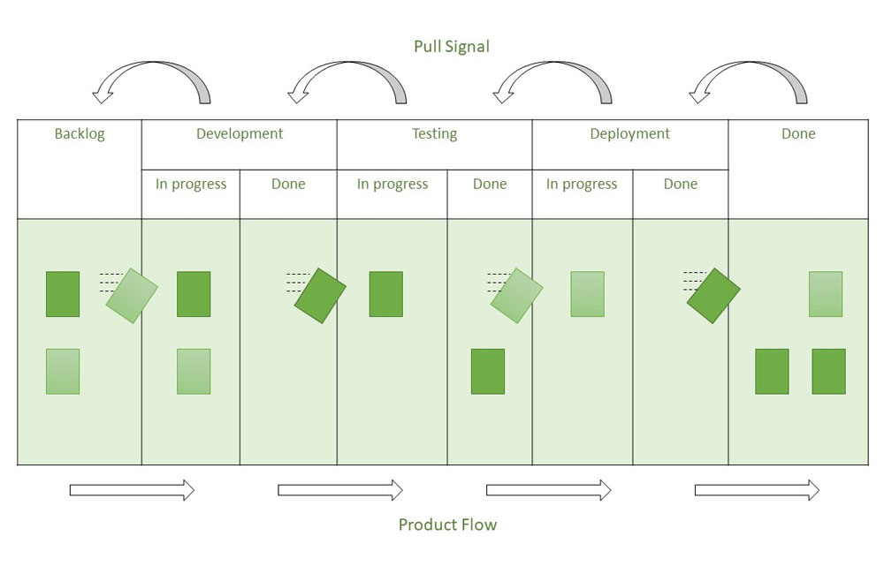
Kanban Methodology

Slide 46


Slide 47
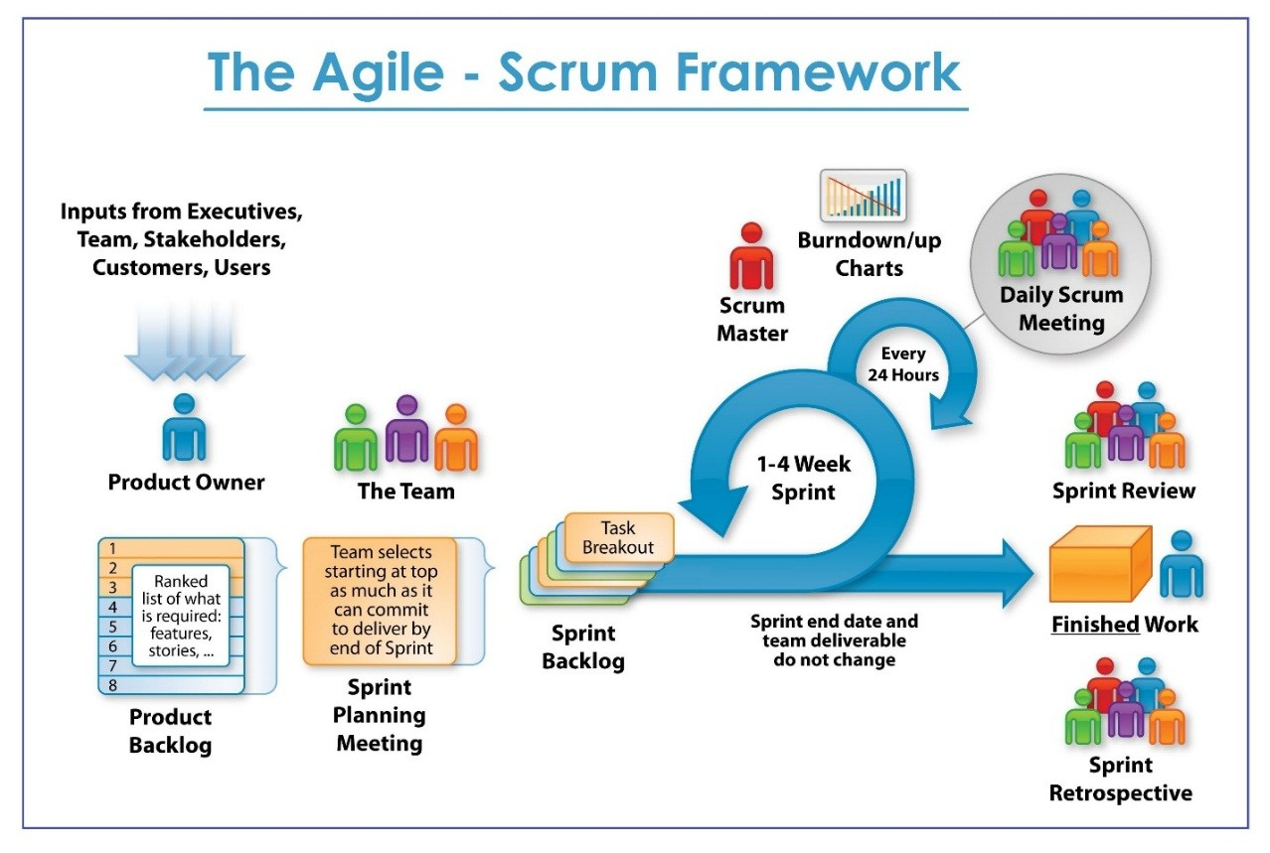

Slide 48
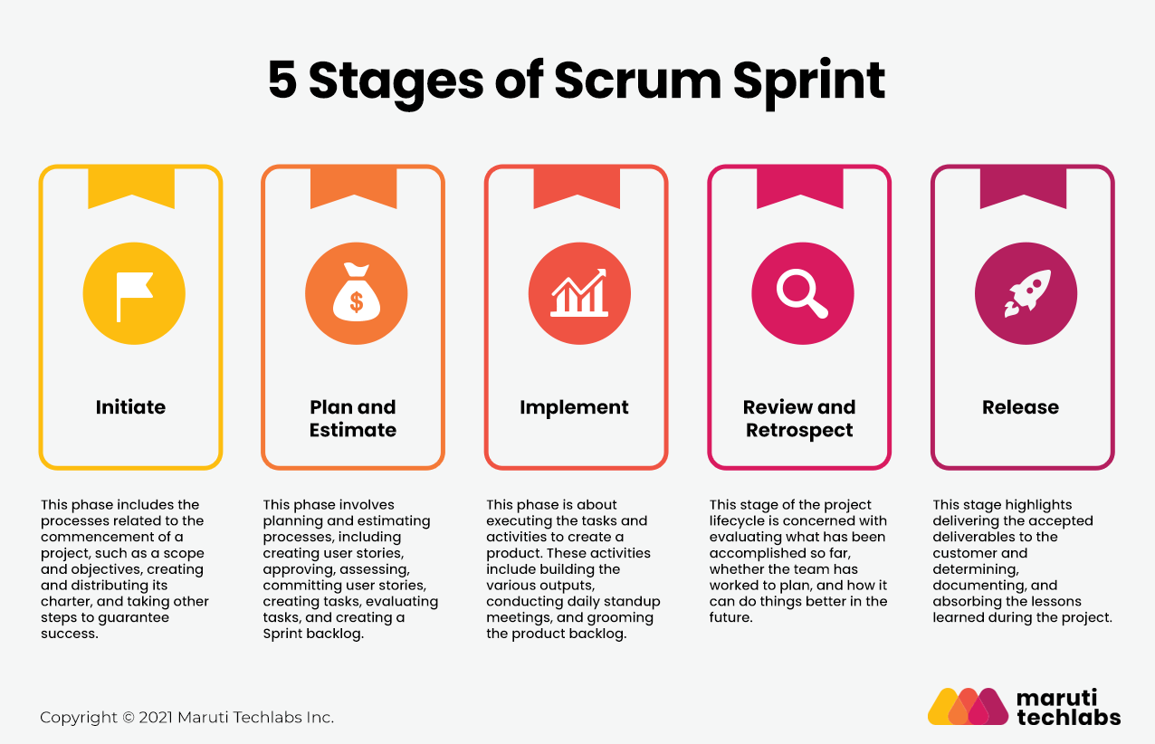

Slide 49
SW Development Process
Agile-SPRINTs

Slide 50
Project Sprints
Detection Alert
Camera Capture
Object Detection
Send messages to other subsystems
AMR Controller
Receive messages and act accordingly
Move using (SLAM) with Obstruction avoidance
Target Acquisition (Obj. Det.) and Tracking
Follow target using camera and motor control
System Monitor
Receive and Display Detection Camera and info
Receive and Display AMR Camera and info
Store, display, and report Information and Alerts

Slide 51
Detection Alert sprint

Slide 52
Sprint 1 - Detection Alert

Slide 53
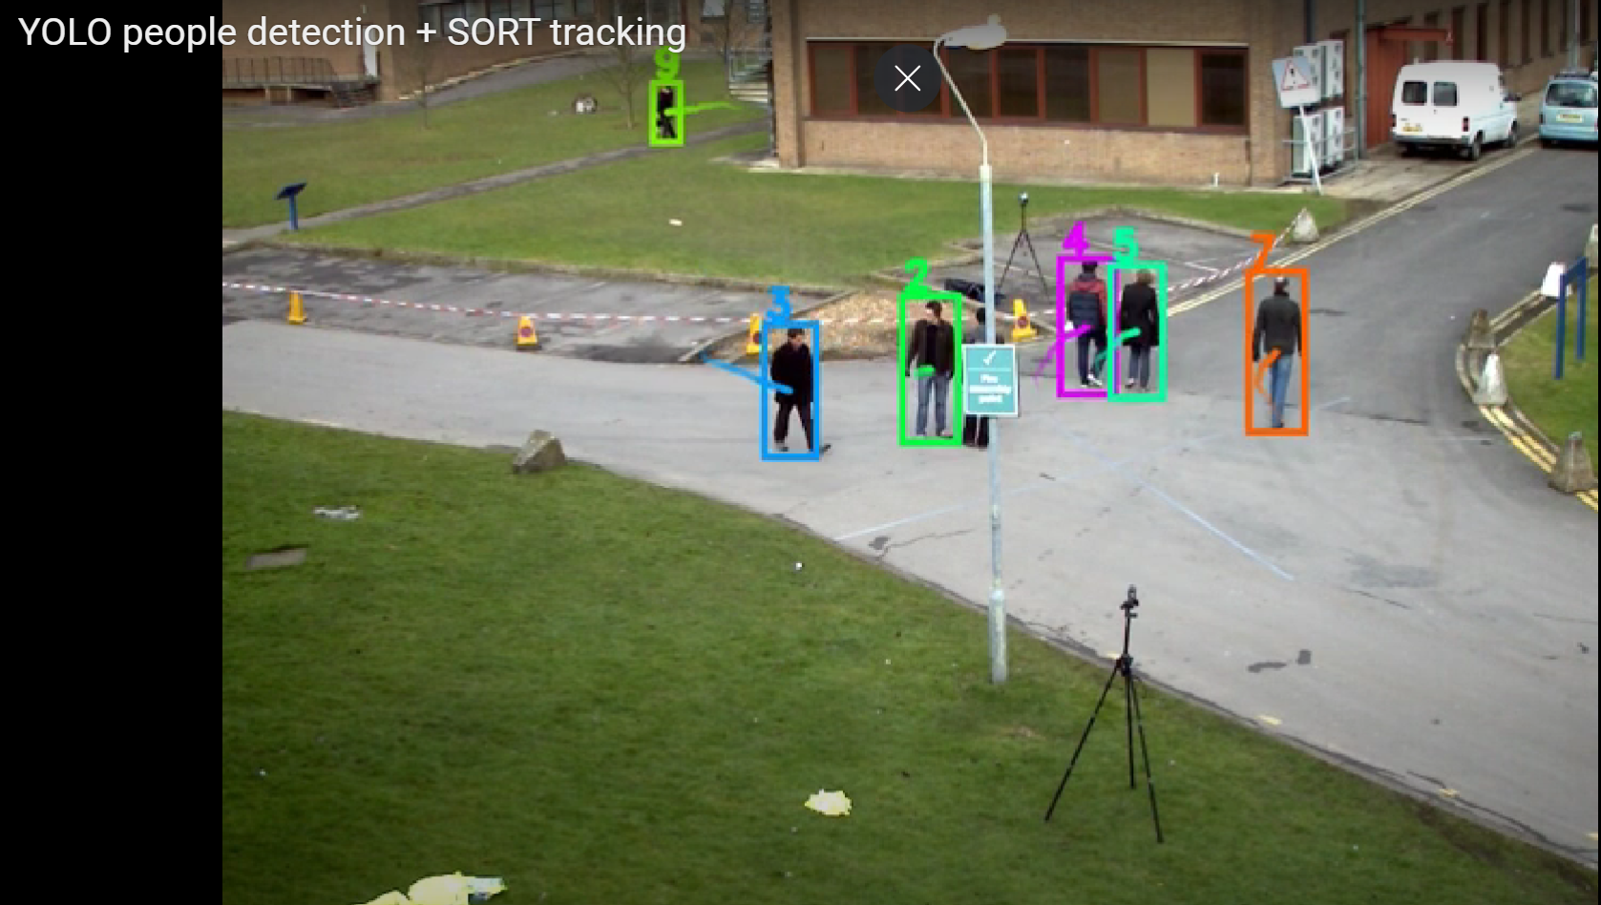
Yolo obj. Det. Vs. Yolo Tracking
Track - Ultralytics YOLO Docs
(469) YOLO people detection + SORT tracking – YouTube
Bing Videos

Slide 54
Visualization – Detailed functional process diagrams
To-Be Functional Process Diagram
Detection Alert
PC or AMR or Both
Remember F.I.T.!!

Slide 55
Team Exercise 4
Perform Detail Design of Detection Alert Module using Process Flow Diagram

Slide 56
Detail Design Review by each team
Using the process flow diagram present team’s design

Slide 57
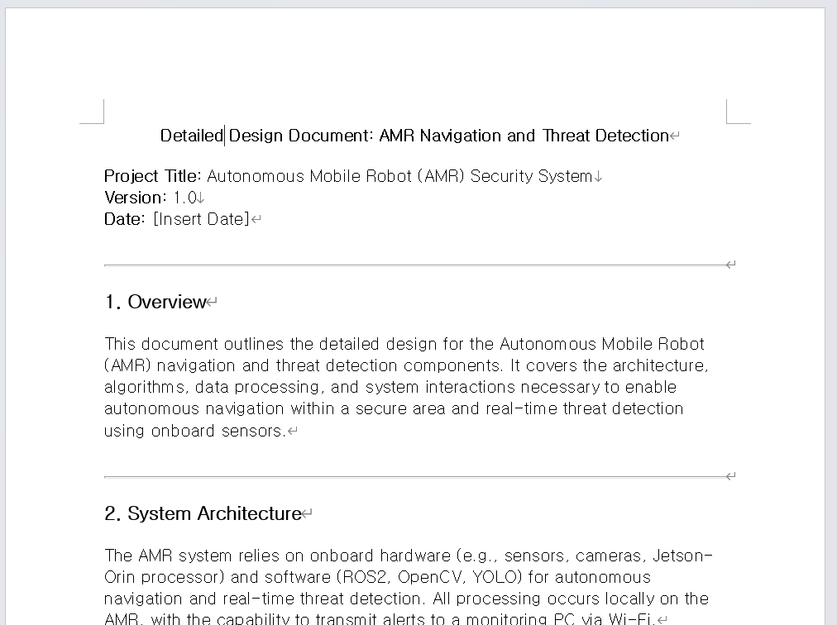
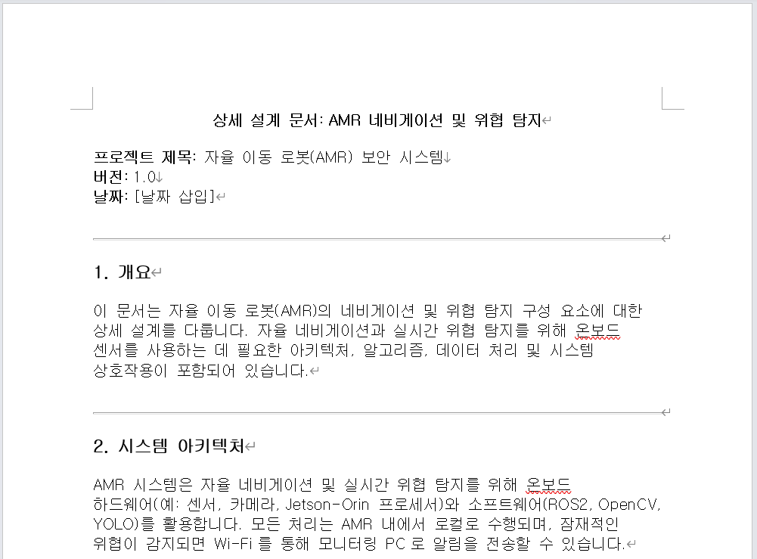
Example Detailed Design Document

Slide 58
Sprint 1 - Detection Alert

Slide 59
Perform Data collection for Detection alert

Slide 60
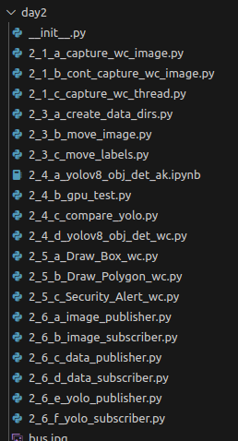
Coding Hints
Image Capture

Slide 61
Coding Hints
Image Capture
Data Labelling
labelImg

Slide 62
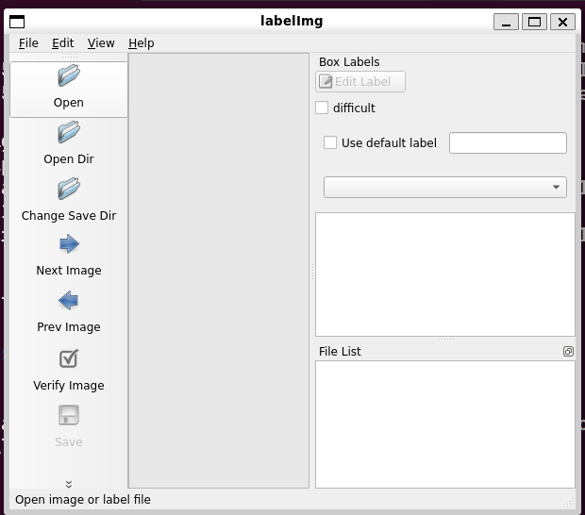
Coding Hints
Data Labelling : use previously installed LabelImg
Or
pip3 install labelImg
May also need “pip3 install PyQt5 lxml”
labelImg

Slide 63
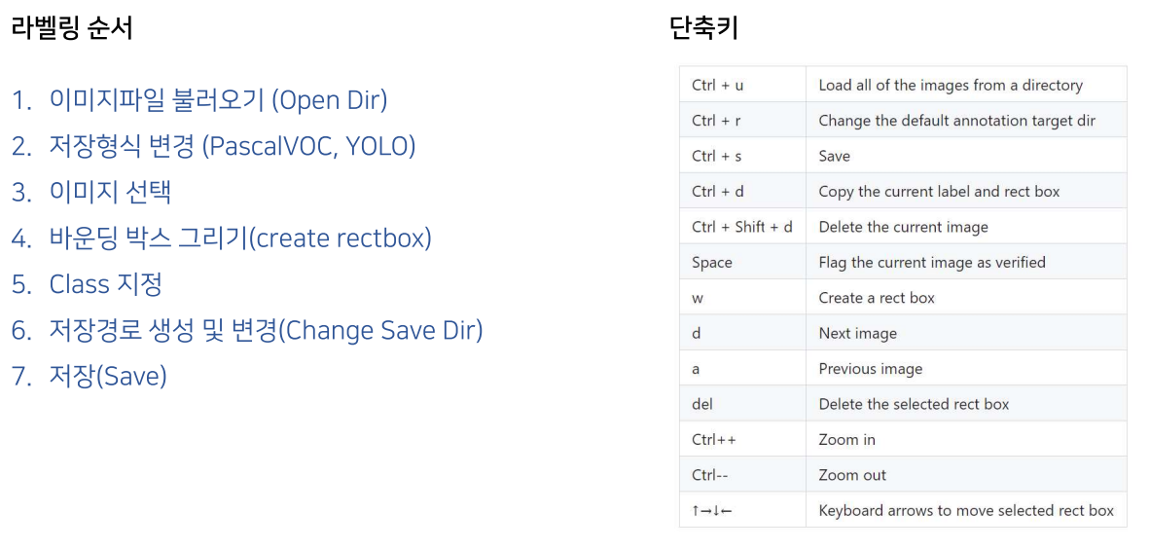
Coding Hints
Data Labelling : LabelImg

Slide 64
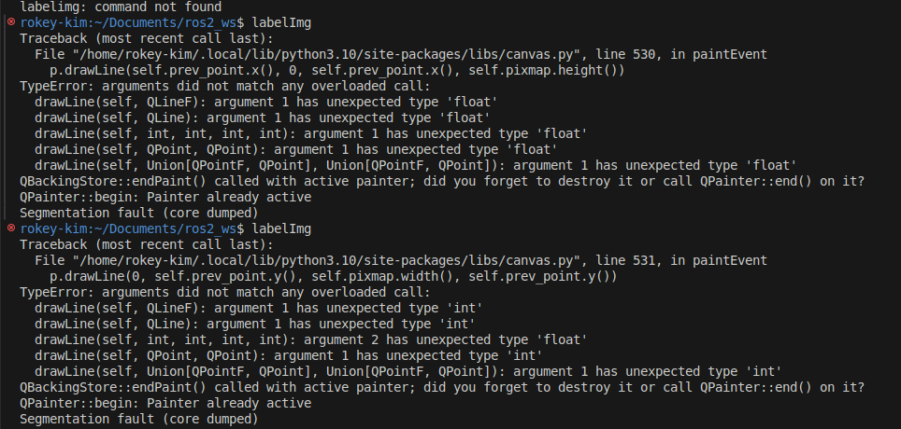
LABELIMG ERROR CORRECTION

Slide 65
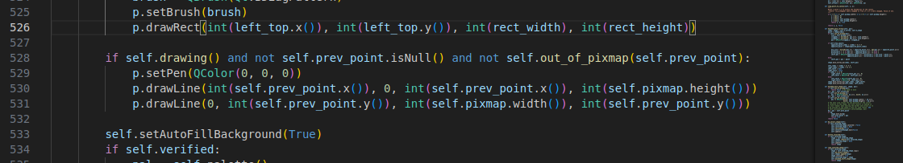
LABELIMG ERROR CORRECTION

Slide 66
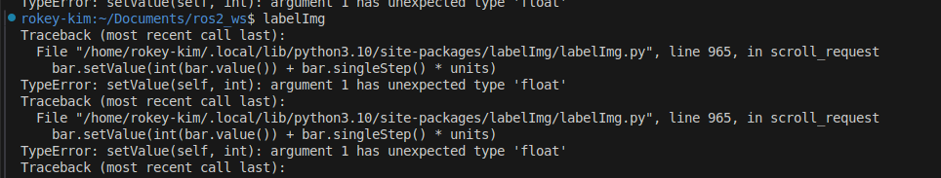
LABELIMG ERROR CORRECTION

Slide 67
Coding Hints
Image Capture
Data Labelling
Data Preprocessing

Slide 68
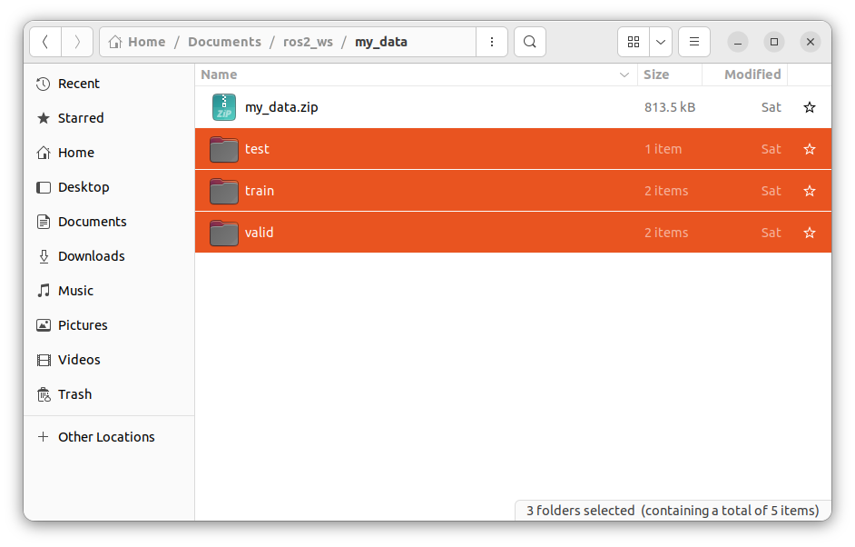
Zip train data Set

Slide 69
Perform Yolo Training & Inference for Detection alert

Slide 70
Coding Hints
Image Capture
Data Labelling
Preprocessing
Yolo8 Object Det

Slide 71
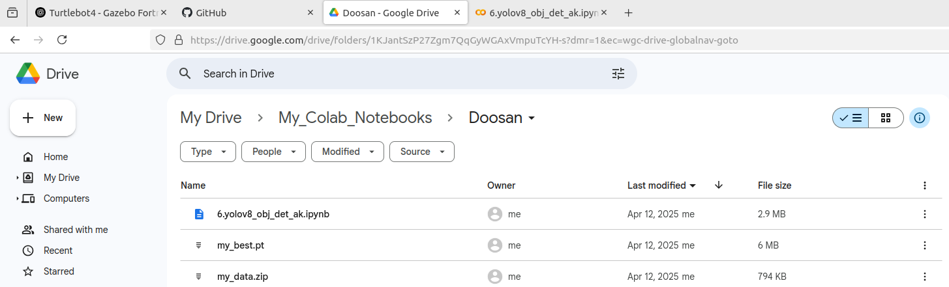
Using google Collab. To create custom model
Move the files to google drive
my_data.zip
yolov8.obj.det.ak.ipynb

Slide 72
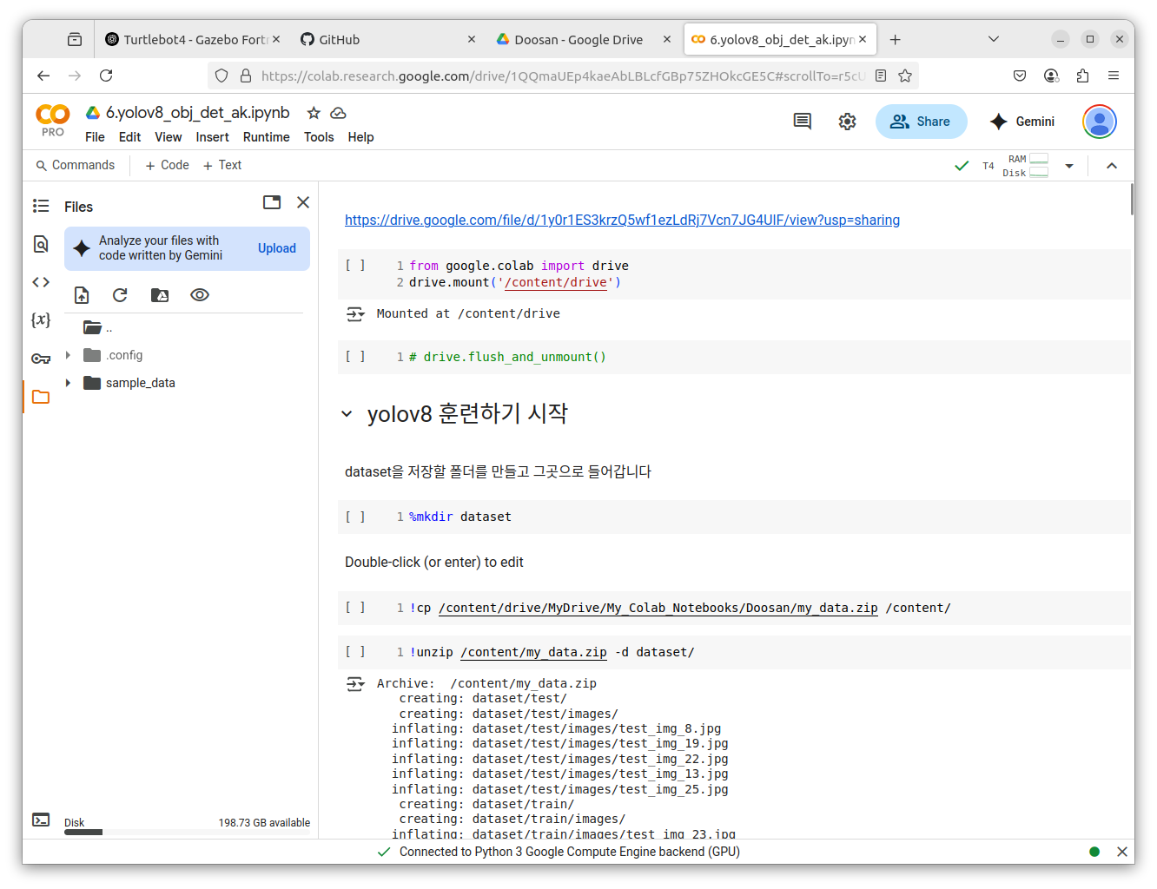
Using google Collab. To create custom model
Move the training script to google collab. and execute line by line

Slide 73
Setting up yolo
pip install --upgrade pip
nvidia-smi # Check if the GPU is available
# If you have a GPU, install the CUDA version of PyTorch
# $ pip install torch torchvision torchaudio --extra-index-url https://download.pytorch.org/whl/cu124
pip install ultralytics

Slide 74
Required Packages Setup
pip list | grep opencv
If doesn’t exist….
pip3 install opencv-python
pip3 install opencv-contrib-python
pip list | grep ultra
If doesn’t exist….
pip install ultralytics

Slide 75
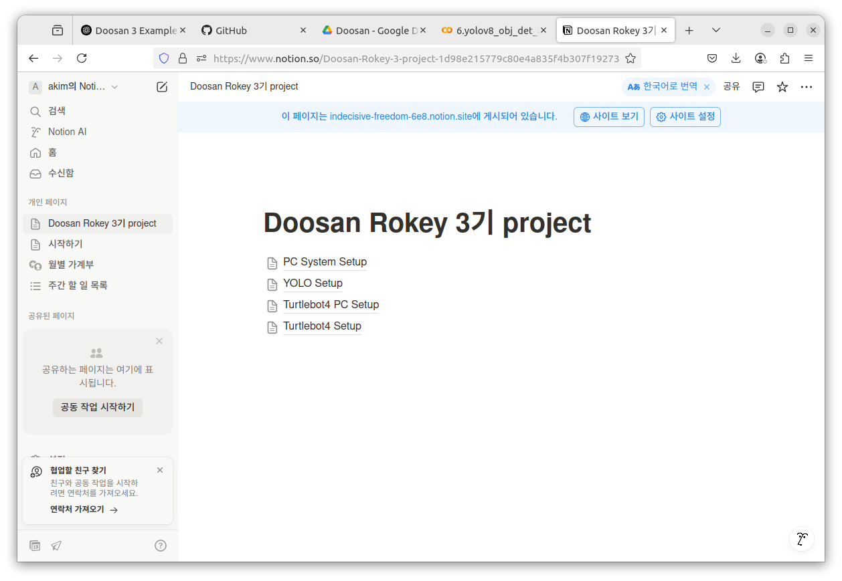
Installing Yolo
YOLO Setup
https://indecisive-freedom-6e8.notion.site/YOLO-Setup-1d98e215779c80f389eefbe0d86ee0ec

Slide 76
Sprint 1 - Detection Alert

Slide 77
How did You/Do you Need to define a Detection area?

Slide 78
Coding Hints
Image Capture
Data Labelling
Preprocessing
Yolo8 Object Det
Create your detection/alert condition

Slide 79
Porting to Ros

Slide 80
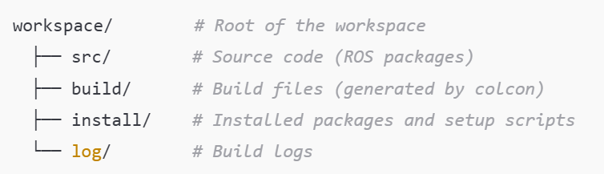
Ros2 Development Workspace
Create workspace
*not created until colcon
mkdir -p ~/rokey3_<grp_letter><grp_num>_ws/src
(i.e. mkdir –p ~/rokey3_A2_ws/src)
cd ~/rokey3_A2_ws
rosdep install --from-paths src --ignore-src -r –y
If not installed…
sudo rosdep init
rosdep update
colcon build
source install/setup.bash

Slide 81
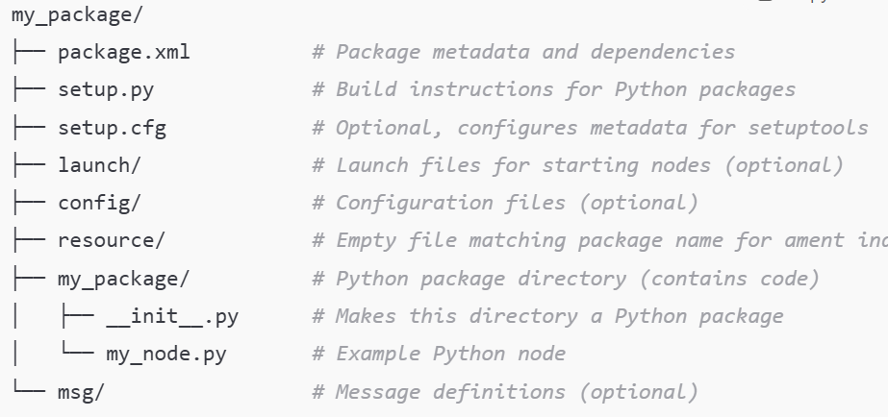
Ros2 Development Workspace
cd ~/rokey3_A2_ws/src
ros2 pkg create --build-type ament_python <my_package>

Slide 82
Ros2 Development Workspace
Write you code below the my_package/ directory under my_package/ package directory

Slide 83
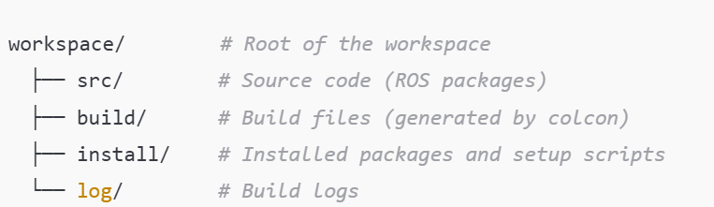
Ros2 Development Workspace
cd ~/ rokey3_A2_ws
colcon build
echo "source ~/ rokey3_A2_ws/install/setup.bash" >> ~/.bashrc
source ~/.bashrc
#check path

Slide 84
Setup bash
ROS_DOMAIN_ID = 0 in .bashrc
source ~/.bashrc
ros2 daemon stop; ros2 daemon start
Make sure discovery setup.bash is not sourced!

Slide 85
Coding Hints
create your team working folder and place files and work from here
mkdir ~/rokey3_<grp_letter><grp_num>_ws
(i.e. mkdir ~/rokey2_A2_ws)

Slide 86
ROS hints

Slide 87
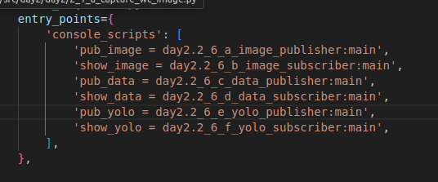
ROS hints
Edit setup.py under<pakage_name> directory add entry for each node
entry_points={ 'console_scripts': [ ‘<command_name> = <package_name>.<code_filename>:main',},
<command_name> is used when ros2 run is executed i.e. data_publisher

Slide 88
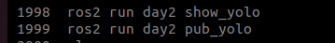
ROS hints
cd ~/rokey3_A2_ws
source ~/rokey1_A2_ws/install/setup.bash
ros2 run <package_name> <command_name>
sudo apt update
sudo apt install terminator

Slide 89
Ros hints
ros2 run rqt_graph rqt_graph
ros2 node list
ros2 node info <node_name>
ros2 topic list
ros2 topic info <topic_name>
ros2 topic echo /chatter
ros2 interface list
ros2 interface show <package_name>/msg/<MessageName>

Slide 90
Team Exercise 5
Perform coding and testing of Detection Alert Module

Slide 91
Sprint 1 - Detection Alert

Slide 92
Expected outcome
Successful object detection
ROS Nodes, and Topics created to send and display images and data

Slide 93
Results & Code Review by each team
Show actual results against the expected results and explain the code written

Slide 94
프로젝트 rule number ONE!!!
Are we still having FUN!

